Slide 1
Introduction to OpenCV for image analysis
Daniel Farber - CougPy Python Working Group 2/8/19

Slide 2
Introduction
A modular package for image and video analysis
Originally written in C
This version: C++ with a Python wrapper
Uses NumPy as a base
Many basic operations similar to matplotlib

Slide 3
Modules
> 40 modules, including:
Core module
Adjust contrast, brightness, etc.
Mask operations
Image processing
Image detection and segmentation
Machine learning
Face and other object detection

Slide 4
Loading an image
Loading a color image (the default):
image = cv.imread(‘Image.jpg’)
Loading a grayscale image:
image = cv.imread(‘Image.jpg’, 0)
Displaying an image:
cv.imshow(‘Figure title’, image)

Slide 5
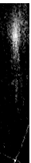

Masks
Arithmetic operations
Adding or subtracting parts of images
Setting pixel values

Slide 6
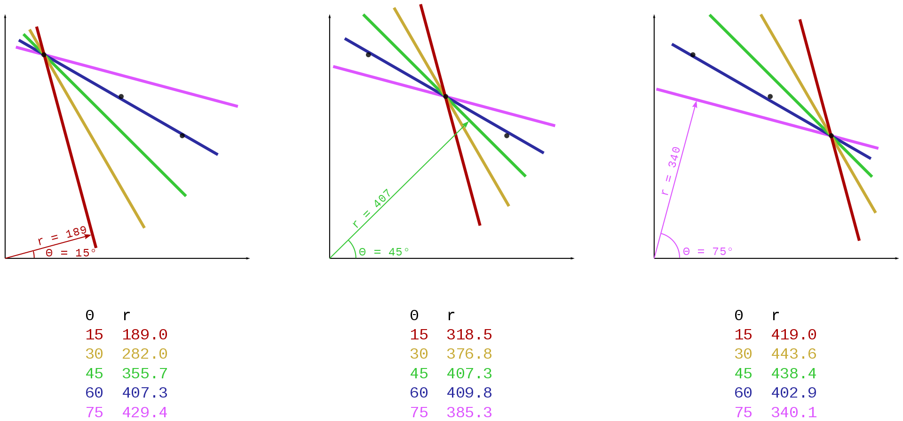
Hough Transform
Originally to identify lines:
Random angled lines emanating from each data point
Most similar length at all points is most probable line:

Slide 7
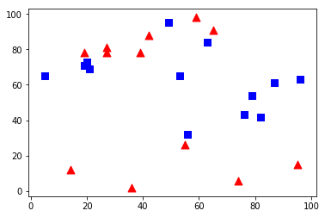
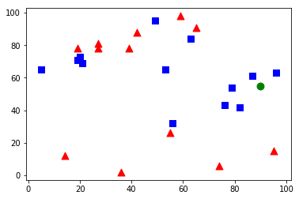
K nearest neighbor
In machine learning (ml) module:
Cv.ml.Knearest_create()
Predicts to which group an unknown belongs
Here blue labeled 1, red labeled 0
result: [[1.]] , neighbours: [[1. 1. 1.]] , distance: [[ 45. 100. 122.]]

Slide 8
Sources
https://opencv-python-tutroals.readthedocs.io/en/latest/py_tutorials/py_tutorials.html
https://en.wikipedia.org/wiki/Hough_transform
https://spaceflightnow.com/2017/02/06/planet-acquires-rival-satellite-company-from-google/

